Slide 1


NAME : M.R.Janani
COLLEGE : Panimalar Institute of Technology
DEGREE : B.TECH
BRANCH : AI&DS
EMAIL : jananijan2114@gmail.com
NM ID : au211521243071
FINAL PROJECT

Slide 2
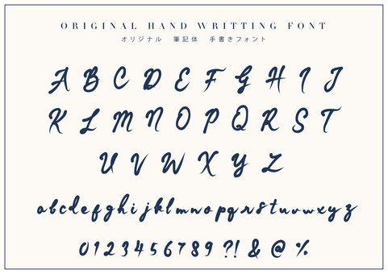
PROJECT TITLE
CHARACTER RECOGNITION USING CNN

Slide 3
AGENDA
Problem statement
Proposed system
System development approach
Algorithm & deployment
Result
conclusion

Slide 4

PROBLEM STATEMENT
The technique for converting a text image into a machine-readable text format is called optical character recognition, or OCR. The computer saves the scan as a digital file, for example if you scan a form or receipt.CNN is used recognize the character easily.Characters in the image can be successfully recognised with the CNN classifier. Traditional CNN classifier architecture consists of fully connected layers after a soft-max layer for classification, and convolutional layers for obtaining features.

Slide 5
PROJECT OVERVIEW
Character recognition analyses characters in images or communications.Character recognition uses CNNs' the ability to effortlessly acquire structural traits from raw pixel opinions. CNNs uses convolutional layers to extract image features as well as fully connected layers to classify. CNNs learn character labels off input images via backpropagation and optimisation methods. CNNs be suitable for OCR and document analysis due to the fact that they can accurately classify character in new images upon train.

Slide 6

WHO ARE THE END USERS?
Businesses and Corporations
Educational Institutions
Government Agencies
Publishing and Media Companies
Retailers and E-commerce Platforms
Healthcare Providers
Individual Users

Slide 7

YOUR SOLUTION & ITS VALUE PROPOSITION
CNNs are excellent for real-time massive data sets as they can learn complicated visual designs and spatial correlations, which helps them function well in character recognition.Develop a CNN architecture with convolutional extraction and classification layers for character recognition. For accurate and productive recognition, modify applications analyze performance, and then make improvements for real-world tasks.

Slide 8
WOW IN YOUR SOLUTION
By effectively learning from raw pixel data, identifying local trends, geographical dependencies, and handling character appearance variants CNNs exceed traditional feature engineering and becomes translation-invariant and robust to real-world scenarios.

Slide 9
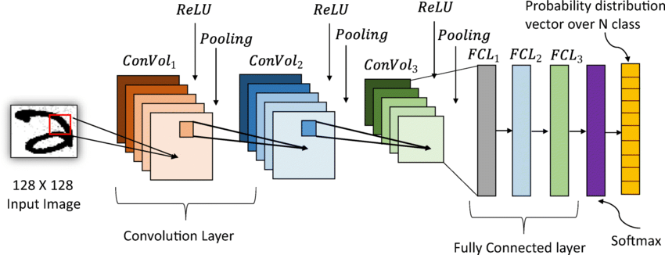
MODELLING

Slide 10

RESULT
CNNs contain convolutional feature extraction layers and fully corresponding classification layers. Convolutional extraction of features and classification layers are utilized to train CNNs to accurately extract character assets from images. This helps to enhance character recognition in OCR and document evaluation.

